Slide 1

Build your first QML Interface

Slide 2

About Me ————————————————————————
KDE developer since Dec 22
working on KDE Eco and occasionally Merkuro (formerly Kalendar)
contributed to VLC in the past

Slide 3

Introduction ————————————————————————
Declarative language
Inline Javascript to handle imperative aspects
Component Based Architecture
Property Bindings
Cross Platform Compatibility
Adaptive UI for any screen size

Slide 4




Some Popular Qt/QML applications ————————————————————————

Slide 5
Demo - Requirements ————————————————————————

Slide 6
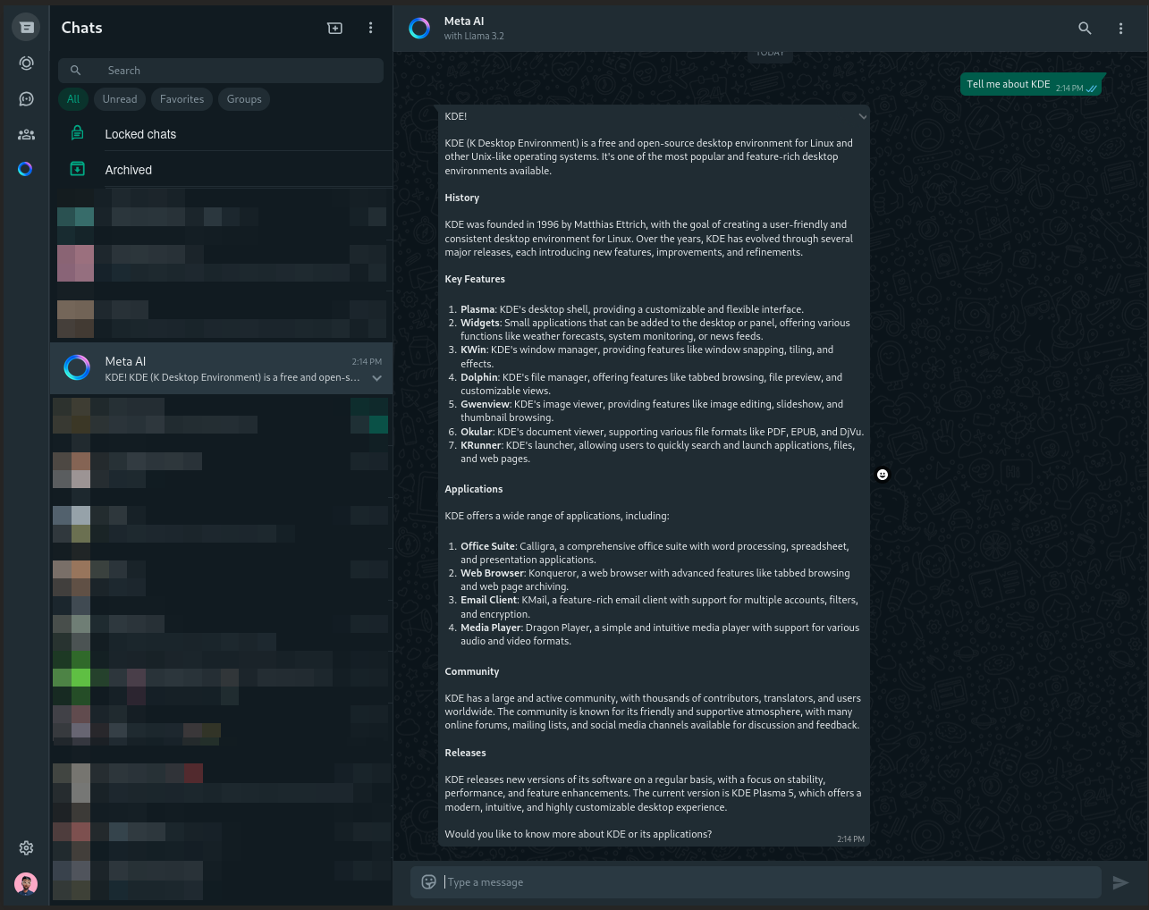
Whatsapp UI (Referrence) ————————————————————————

Slide 7
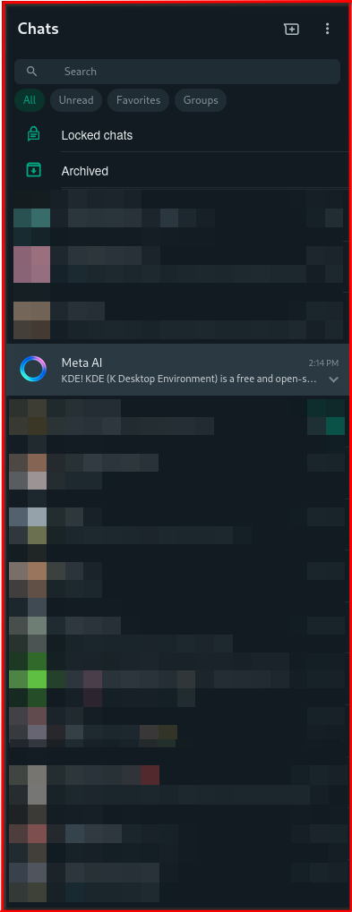
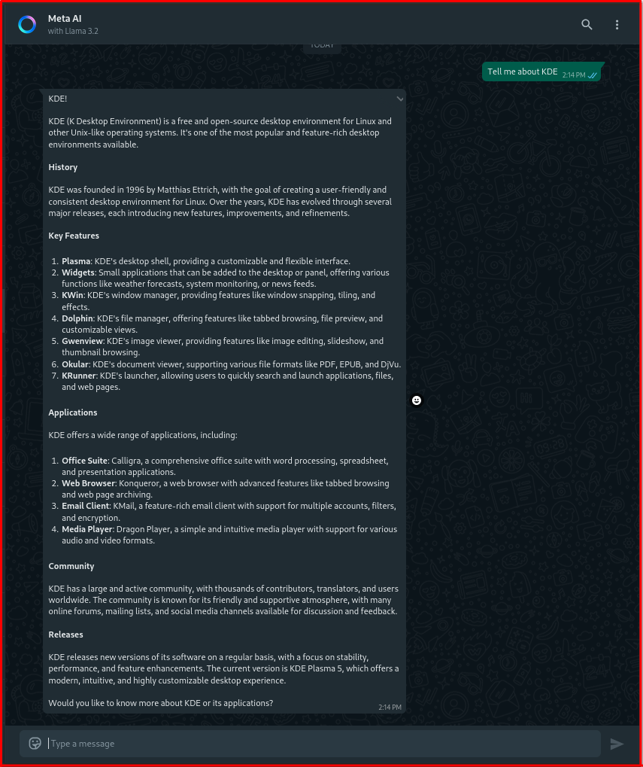
3. Conversation Box
1.Sidebar
2. Chat List

Slide 8
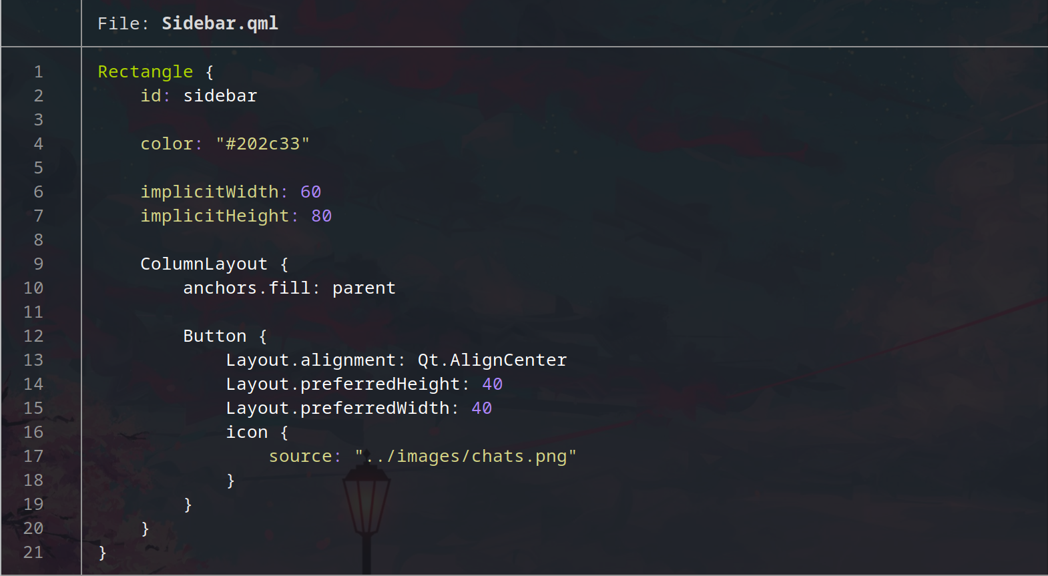
Sidebar ————————————————————————

Slide 9

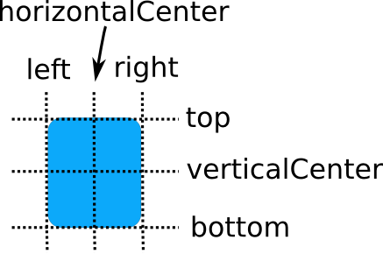
Positioning elements inside QML ————————————————————————
Layouts
ColumnLayout
B. RowLayout
Anchors

Slide 10
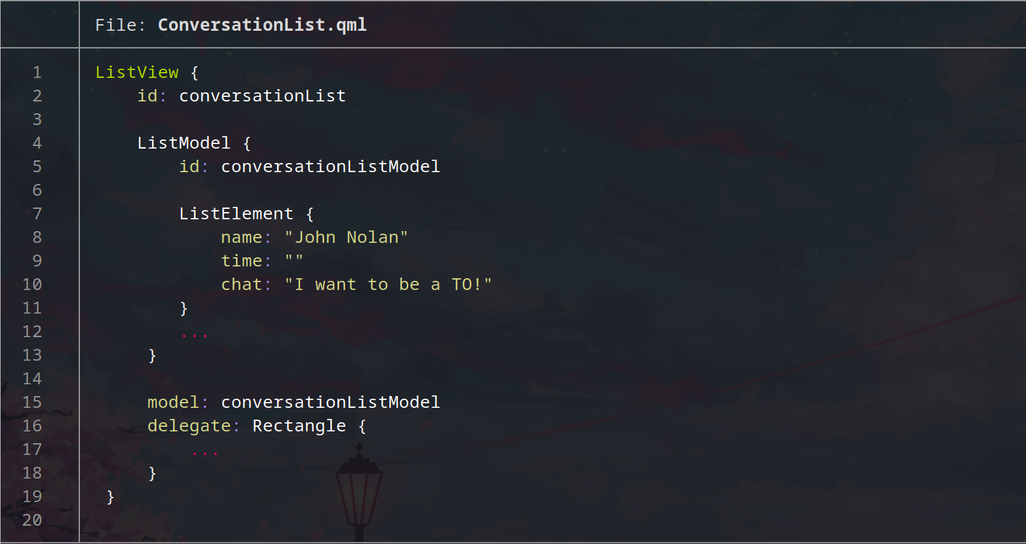
Conversation List ————————————————————————

Slide 11
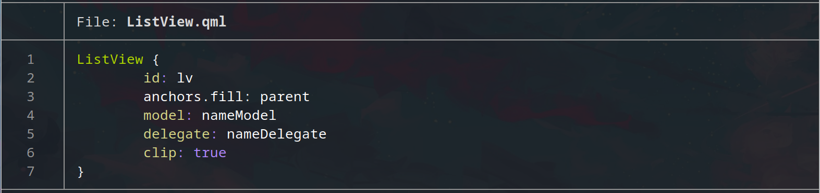
ListView ————————————————————————
A ListView displays data from models created from built-in QML types like ListModel and XmlListModel, or custom model classes defined in C++ that inherit from QAbstractItemModel or QAbstractListModel.
ListView will only load as many delegate items as needed to fill up the view. Items outside of the view will not be loaded unless a sufficient cacheBuffer has been set.

Slide 12
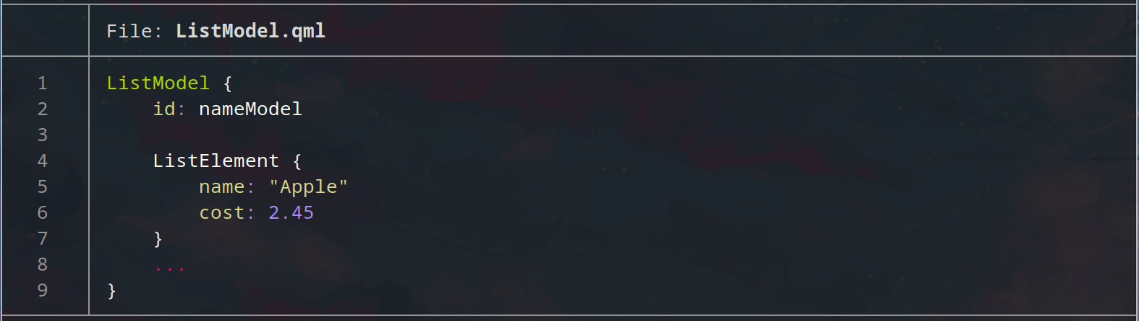
ListModel ————————————————————————
The ListModel is a simple container of ListElement definitions, each containing data roles. The contents can be defined dynamically, or explicitly in QML.
ListElement represent items in a list that will be displayed using ListView or Repeater items.
ListElement contain a collection of role definitions instead of properties. Roles define both how the data is accessed and include the data itself.

Slide 13
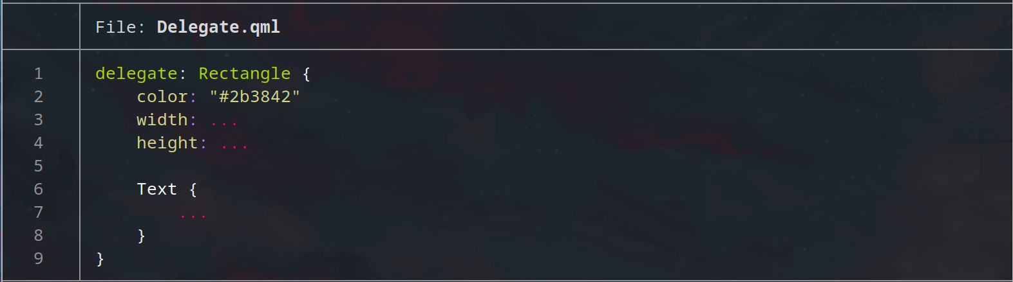
Delegate ————————————————————————
The delegate provides a template defining each item instantiated by the view.

Slide 14
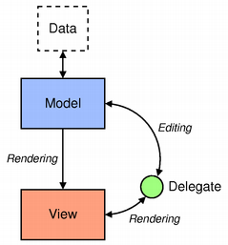
Model View Architecture ————————————————————————
Qt contains a set of item view classes that use a model/view architecture to manage the relationship between data and the way it is presented to the user.

Slide 15

THANK YOU

